Slide 1
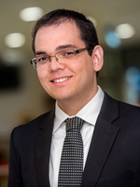
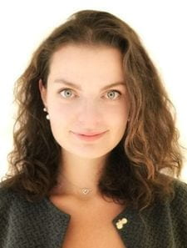
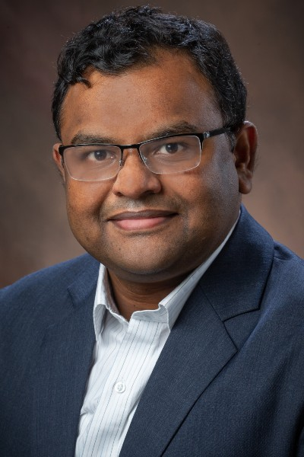
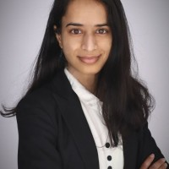
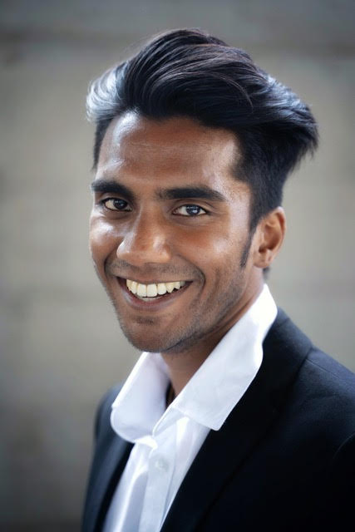
Designing Fair and Inclusive NFT Projects: The Case of Student-Athletes' Name, Image, and Likeness
Dr. Arthur Carvalho
Miami University
Dr. Liudmila Zavolokina
Univ. of Zurich
Dr. Suman Bhunia
Miami University
Monu C.
Miami University
Nithi Y.
Univ. of Zurich

Slide 2
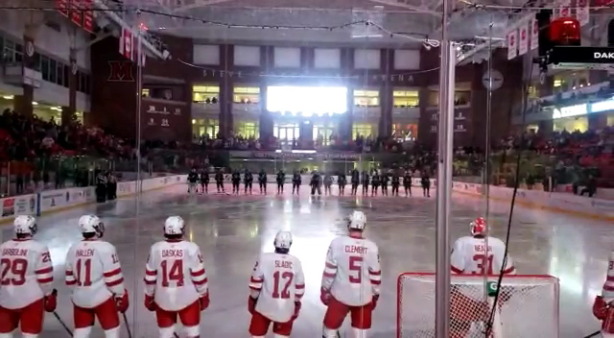

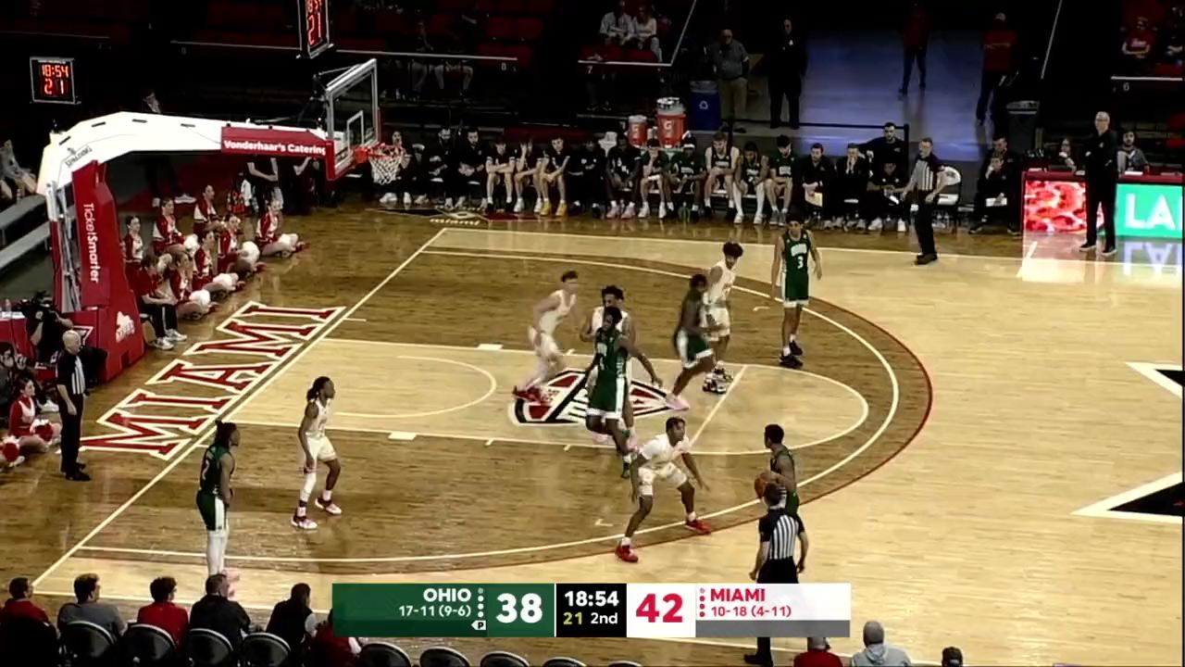

College Sports
College sports are an inherent aspect of many (American) higher-education institutions

Slide 3
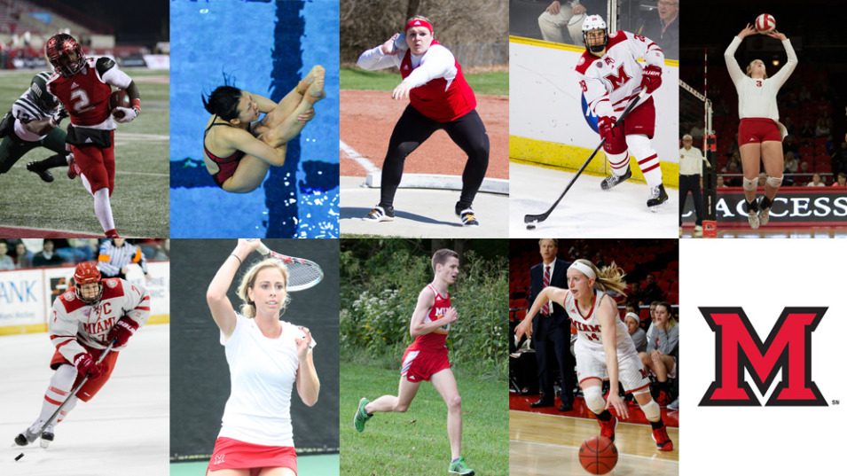


College Sports
Student-athletes
Full-time students
(Previously) Amateur athletes
May be on athletic scholarships
Some organizations oversee athletic scholarships in the United States
National Association of Intercollegiate Athletics (NAIA)
National Collegiate Athletic Association (NCAA)

Slide 4
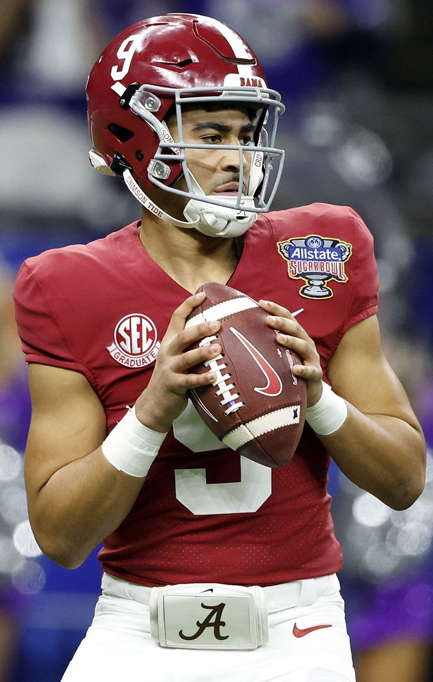
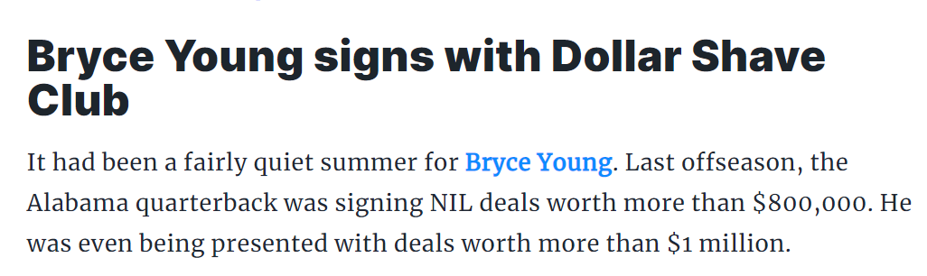


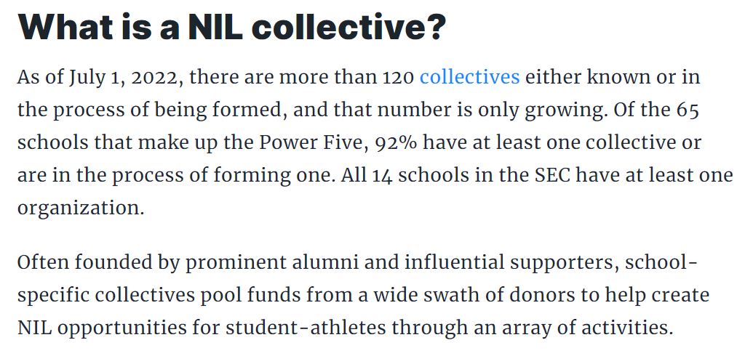


College Sports
Policy change on June 30, 2021
NCAA student-athletes can now profit from their name, image, and likeness (NIL)
Source: https://www.on3.com/nil

Slide 5



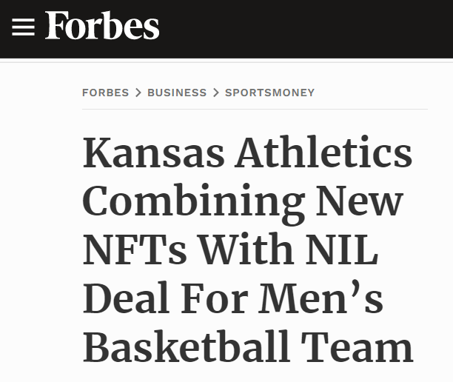
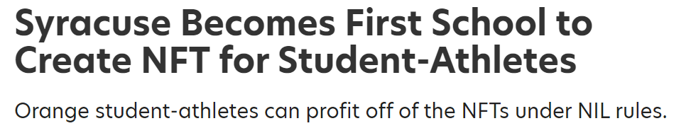
College Sports
Natural event: NFT platforms focusing on NILs
… and universities too
https://www.si.com/college/syracuse/recruiting/syracuse-first-school-nft-student-athletes-nil-deal

Slide 6
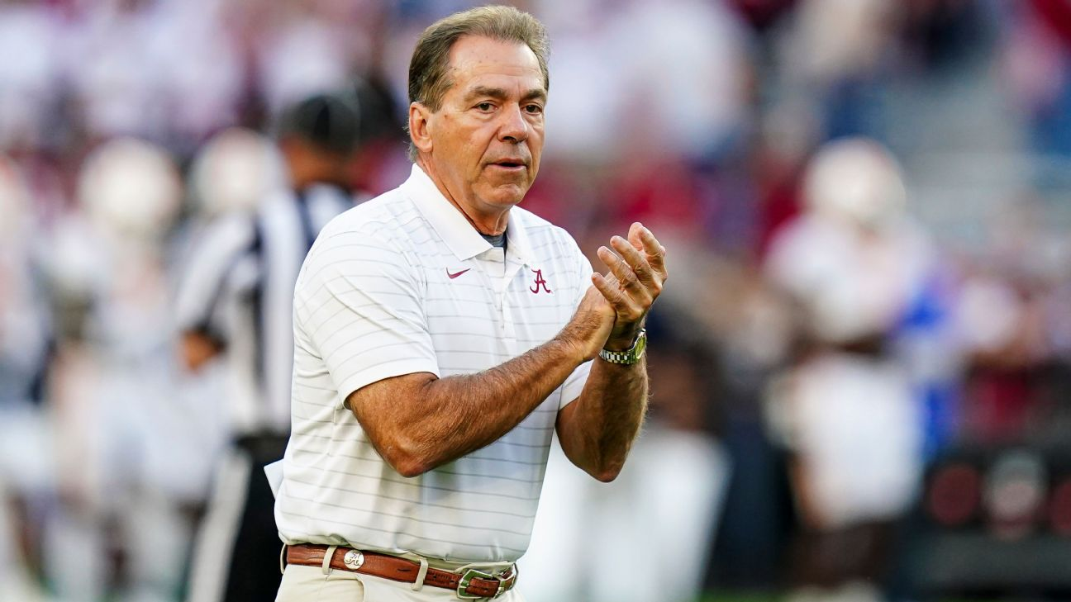
College Sports
Hard reality
It is highly unlikely that the 500,000 active NCAA student-athletes will make any money from NIL deals
“Everything in high school and college football has always been equal for everyone. It’s not going to be that way anymore . . . Certain positions probably enhance [the] opportunity to create value, like [a] quarterback.”
Nick Saban
(American) Football Coach
University of Alabama

Slide 7
College Sports
Other important facts:
98% of NCAA student-athletes do not become professional athletes
Student-athletes might not have the same opportunities as other students, e.g., access to summer internships
Student-athletes may be one injury away from losing their scholarships

Slide 8


College Sports
Concerns guiding our research:
Inclusiveness
How can all student-athletes have access to NIL financial resources?
Fairness
How can all student-athletes have a fair share of NIL financial resources?

Slide 9
1-Slide Summary
Study on the prospect of NFTs creating NIL opportunities
Royalties
Each student-athlete is automatically rewarded whenever there is a transaction (sale or transfer)
Randoms Packs
Collectibles are sold in random packs in primary markets
Inclusiveness: enables all student-athletes to collect royalties
Direct Sales
Royalties are also collected after sales in secondary markets
Fairness: the most popular student-athletes are likely to receive more royalties in the long term
Notes:
Sold by universities, collectives, etc. It does not matter who mint

Slide 10
Research Methodology
Design Science
Peffers K, Tuunanen T, Rothenberger MA, Chatterjee S (2007) “A Design Science Research Methodology for Information Systems Research,” Journal of Management Information Systems 24(3):45–77.
Steps
Problem identification
Objectives for a solution
Design of the artifact
Demonstration of the artifact
Evaluation of the artifact
Communication

Slide 11
Problem Identification & Objectives for a Solution
Problem identification
“Define the specific research problem and justify the value of a solution” (Peffers et al., 2007)
Objectives for a solution
“Infer the objectives of a solution from the problem definition and knowledge of what is possible and feasible” (Peffers et al., 2007)
Defined in terms of design principles
An artifact’s generic capabilities that address the previously defined problems

Slide 12
Problem Identification & Objectives for a Solution
Semi-structured interviews with 12 student-athletes
Four different academic institutions in the United States
Division I players

Slide 13
Problem Identification & Objectives for a Solution
Sample questions:
“What is your opinion on the recently proposed changes to name-image-likeness (NIL) regulations by the NCAA?”
“Among all the student-athletes, who do you think will benefit the most financially from the NCAA’s recent changes to NIL regulations?”
Summary of the main findings:
Consensus on the positivity of the NIL regulatory changes
Consensus on who will profit from NIL deals
Most popular athletes from the most popular sports
Agreement that athletes should be rewarded differently

Slide 14
Problem Identification & Objectives for a Solution
Sample answer:
“I guess the sports that make the most revenue normally [are more likely to have NIL deals]. So, I feel like athletes, who are in bigger name sports — such as football or basketball — that have like a large following and attention from the media.”
Design Principle #1 (Inclusiveness):
All student-athletes should have access to NIL financial resources
Notes:
solution aiming at helping student-athletes secure NIL opportunities.

Slide 15
Problem Identification & Objectives for a Solution
Sample answer:
“There are guys making lots of money from what I understand who, honestly, are one hop away from being a professional . . . so I feel it [NIL endorsement] is warranted because of the revenue they [star student-athletes] create.”
Design Principle #2 (Fairness):
The allocation of NIL financial resources should treat equals equally and unequals unequally
Notes:
solution aiming at helping student-athletes secure NIL opportunities.

Slide 16
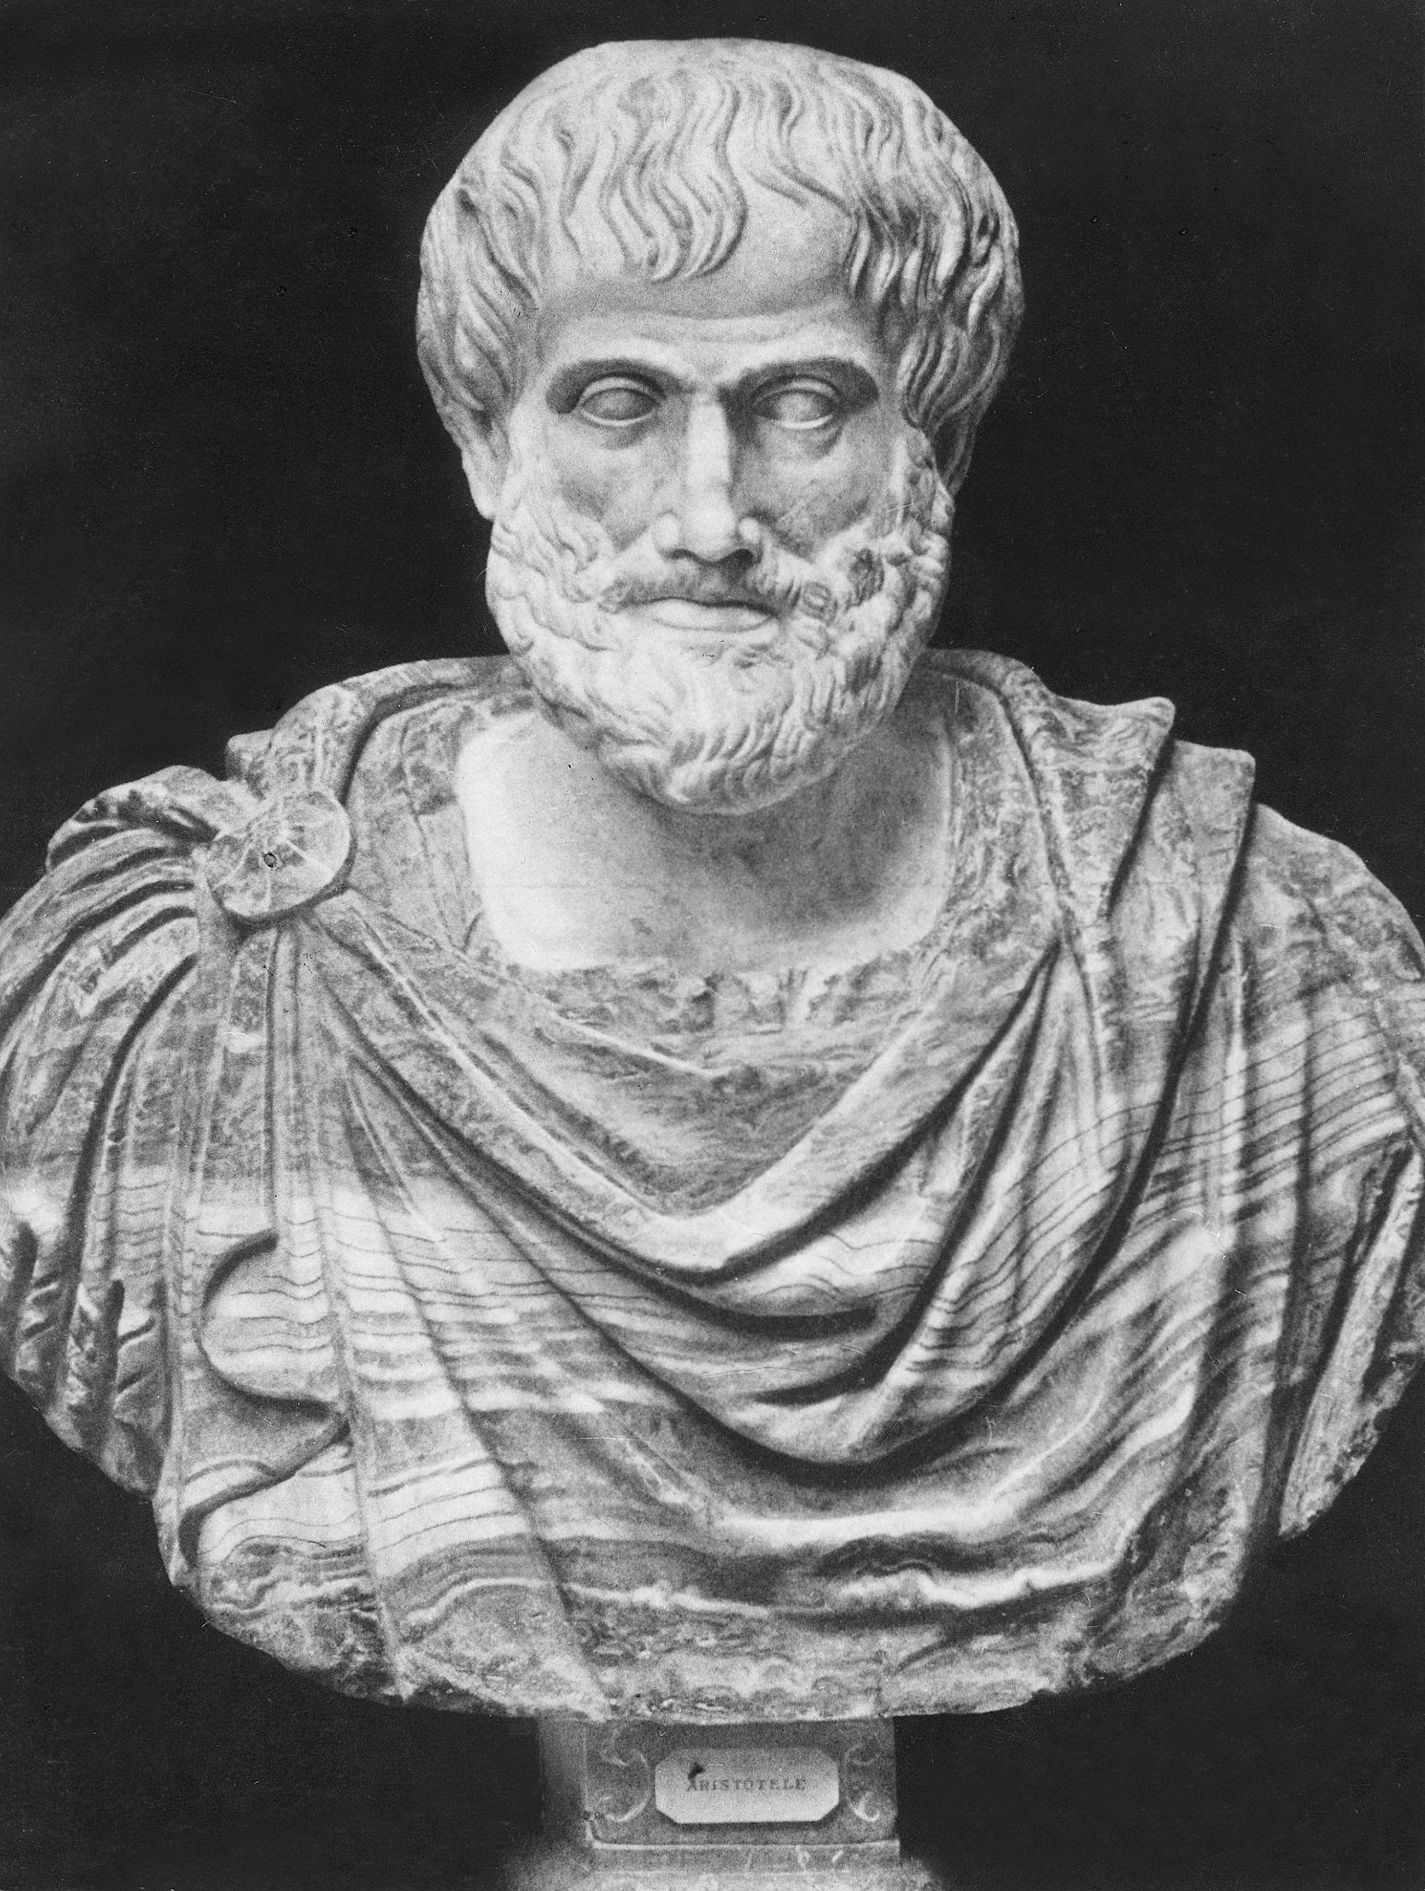
Problem Identification & Objectives for a Solution
Design Principles
Inclusiveness
Student-athletes have a non-zero chance of receiving financial resources
Fairness
Aristotle’s equality principle: “equals should be treated equally, and unequals unequally”
Theories to backup design principles?
Transaction cost economics, information asymmetry, and privacy theories do not seem appropriate

Slide 17
Artifact Design
Digital collectibles as NFTs
Each associated with a single student-athlete
NFTs allow for programable royalties
Design features connected with design principles
Design Feature #1 (inclusiveness)
Student-athletes receive royalties from sales of random packs of collectibles in primary markets
Design Feature #2 (fairness)
Student-athletes receive royalties after an exchange/sale of collectibles for money in secondary markets

Slide 18
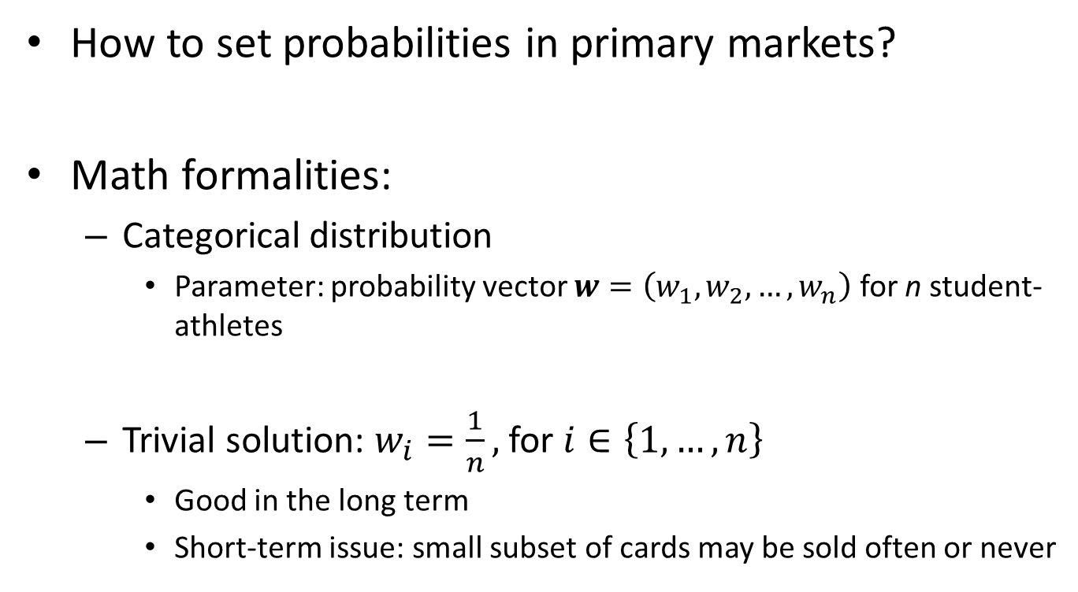
Artifact Design
How to set probabilities in primary markets?
Math formalities:
Categorical distribution
Parameter: probability vector $w=\left(w_{1},w_{2},…,w_{n}\right)$ for n student-athletes
Trivial solution: $w_{i}=\frac{1}{n},$for $i∈\left\{1, …,n\right\}$
Good in the long term
Short-term issue: small subset of cards may be sold often or never

Slide 19
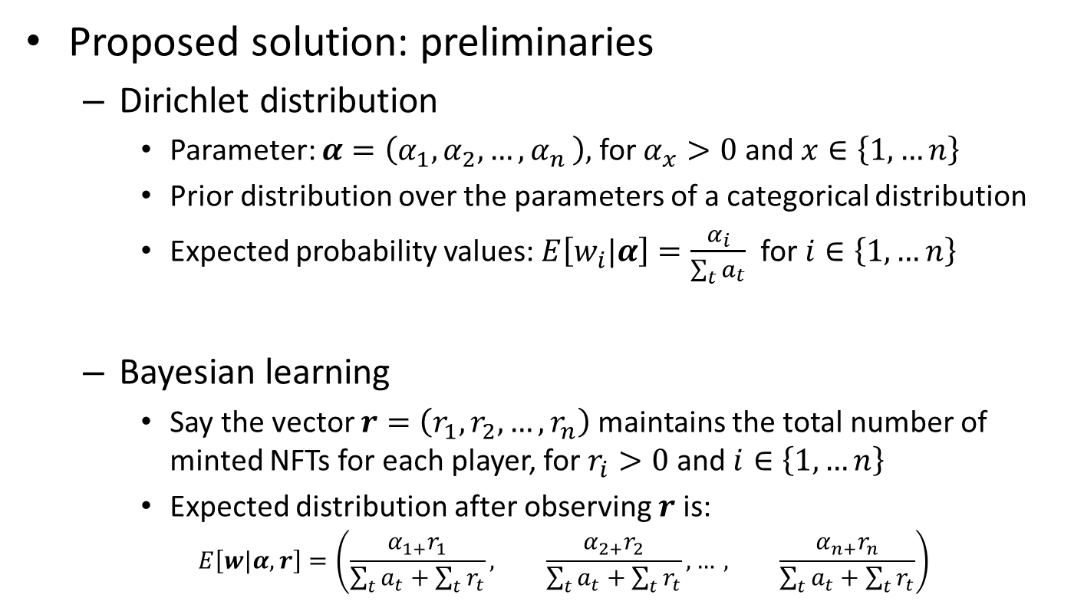
Artifact Design
Proposed solution: preliminaries
Dirichlet distribution
Parameter: $α=\left(α_{1},α_{2},{…, α}_{n}\right),$ for $α_{x}>0$ and $x∈\left\{1,…n\right\}$
Prior distribution over the parameters of a categorical distribution
Expected probability values: $E\left[w_{i}|α\right]=\frac{α_{i}}{\sum_{t}{a_{t}}}$ for $i∈\left\{1,…n\right\}$
Bayesian learning
Say the vector $r=\left(r_{1},r_{2},…,r_{n}\right)$ maintains the total number of minted NFTs for each player, for $r_{i}>0$ and $i∈\left\{1,…n\right\}$
Expected distribution after observing $r$ is:
$$E\left[w|α,r\right]=\left(\frac{α_{1+}r_{1}}{\sum_{t}{a_{t}}+\sum_{t}{r_{t}}}, \frac{α_{2+}r_{2}}{\sum_{t}{a_{t}}+\sum_{t}{r_{t}}},…, \frac{α_{n+}r_{n}}{\sum_{t}{a_{t}}+\sum_{t}{r_{t}}}\right)$$

Slide 20
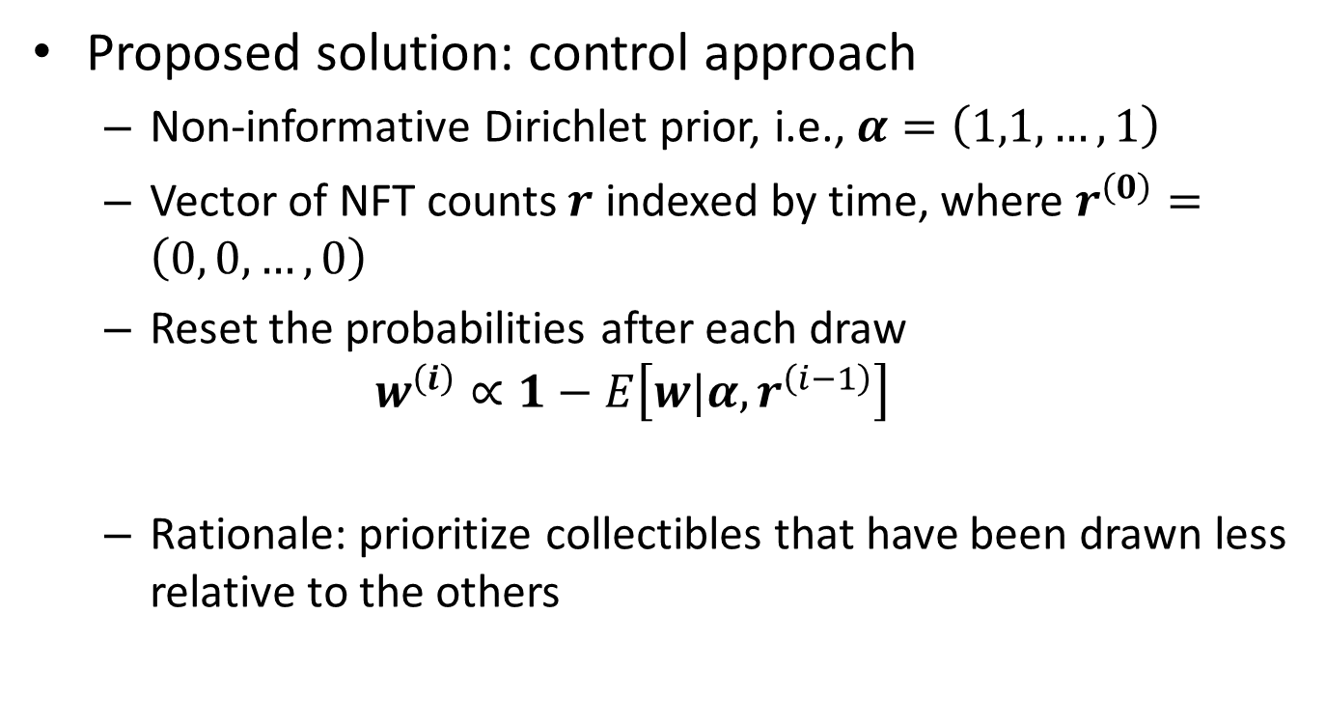
Artifact Design
Proposed solution: control approach
Non-informative Dirichlet prior, i.e., $α=\left(1,1,…,1\right)$
Vector of NFT counts $r$ indexed by time, where $r^{\left(0\right)}=\left(0, 0,…,0\right)$
Reset the probabilities after each draw
$$w^{\left(i\right)}∝1−E\left[w|α,r^{\left(i−1\right)}\right]$$
Rationale: prioritize collectibles that have been drawn less relative to the others

Slide 21
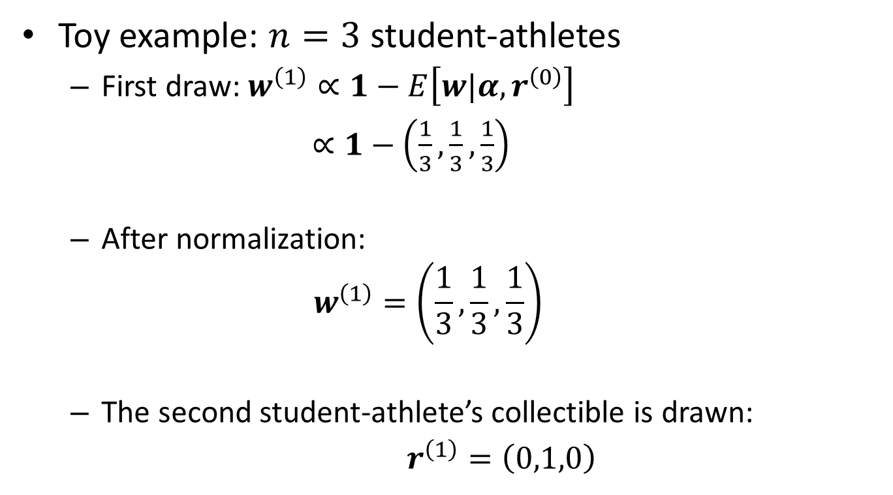
Artifact Design
Toy example: $n=3$ student-athletes
First draw: $w^{\left(1\right)}∝1−E\left[w|α,r^{\left(0\right)}\right]$
$∝1−\left(\frac{1}{3},\frac{1}{3},\frac{1}{3}\right)$
After normalization:
$$w^{\left(1\right)}=\left(\frac{1}{3},\frac{1}{3},\frac{1}{3}\right)$$
The second student-athlete’s collectible is drawn:
$r^{\left(1\right)}=\left(0,1,0\right)$

Slide 22
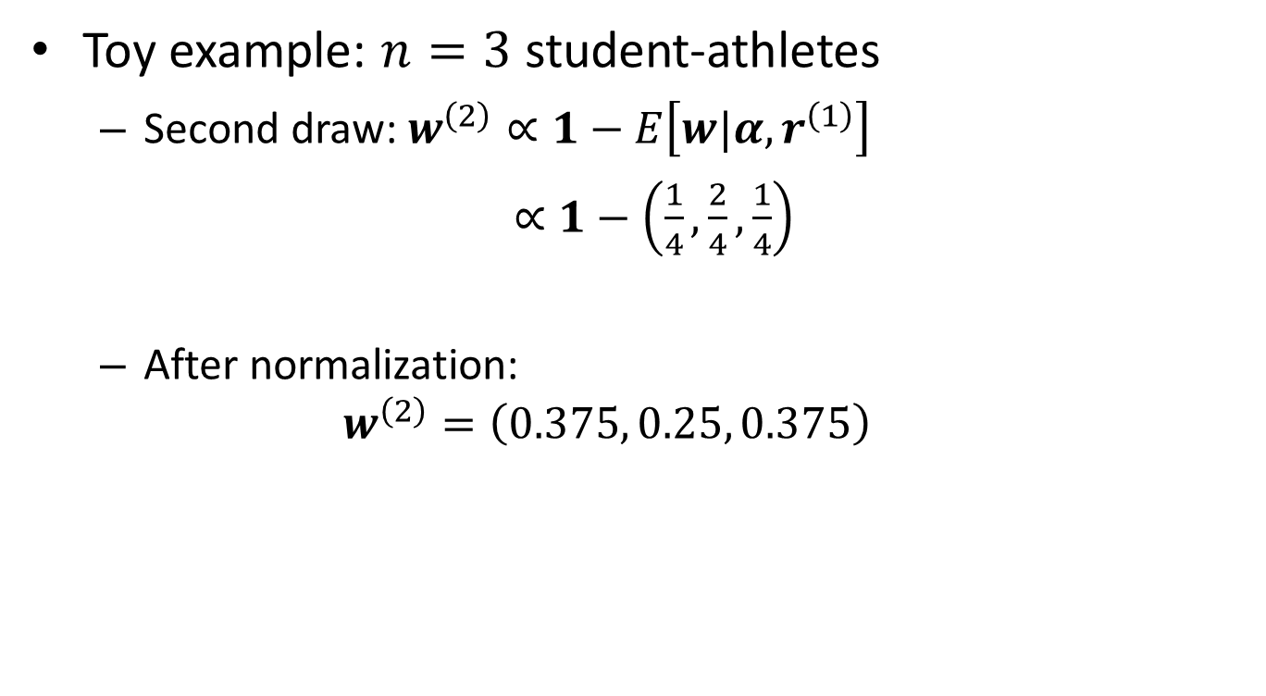
Artifact Design
Toy example: $n=3$ student-athletes
Second draw: $w^{\left(2\right)}∝1−E\left[w|α,r^{\left(1\right)}\right]$
$∝1−\left(\frac{1}{4},\frac{2}{4},\frac{1}{4}\right)$
After normalization:
$$w^{\left(2\right)}=\left(0.375, 0.25, 0.375\right)$$

Slide 23
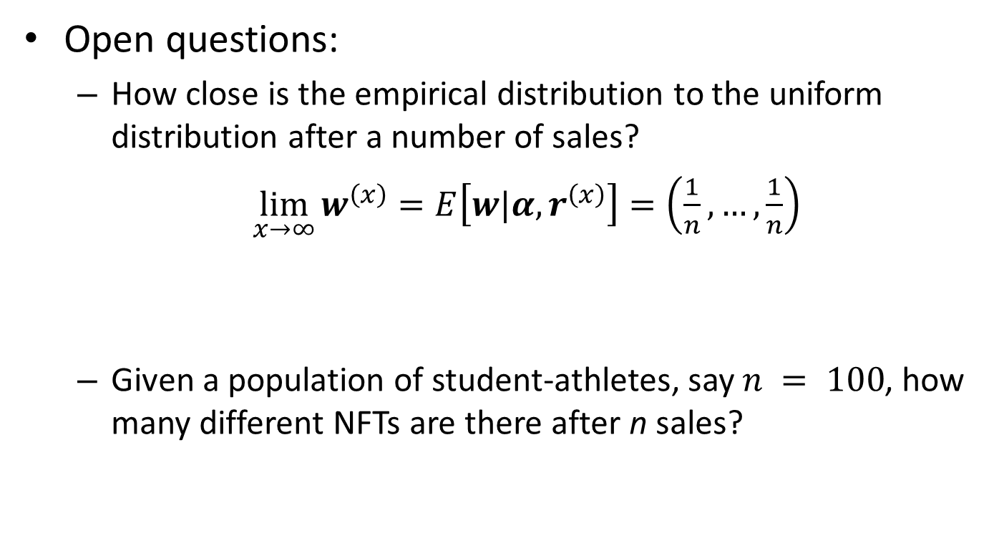
Artifact Design
Open questions:
How close is the empirical distribution to the uniform distribution after a number of sales?
$\lim_{x→∞}{w^{\left(x\right)}=E\left[w|α,r^{\left(x\right)}\right]=\left(\frac{1}{n},…,\frac{1}{n}\right)}$
Given a population of student-athletes, say $n = 100$, how many different NFTs are there after n sales?

Slide 24
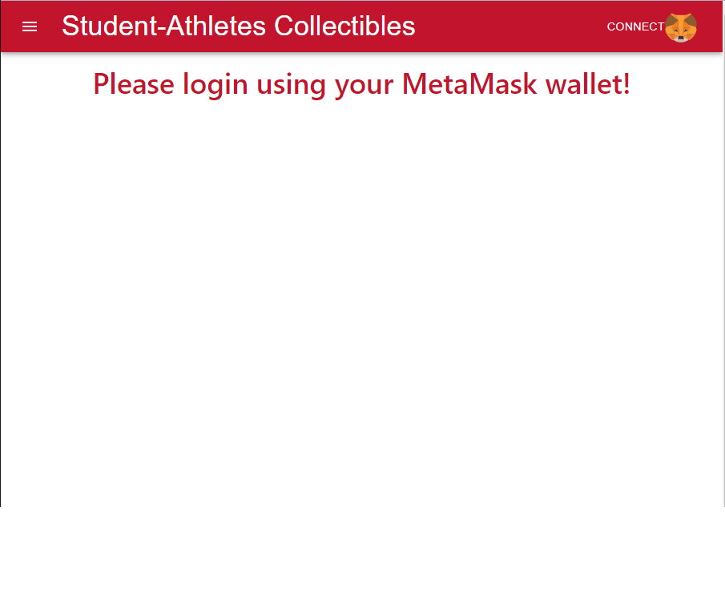
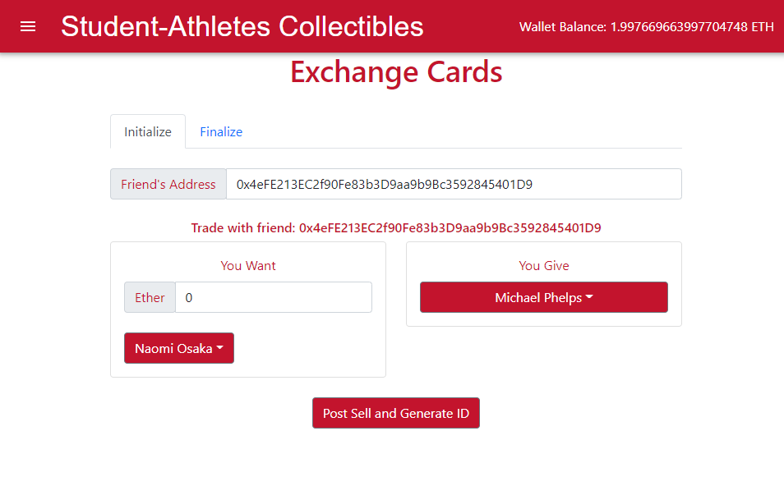
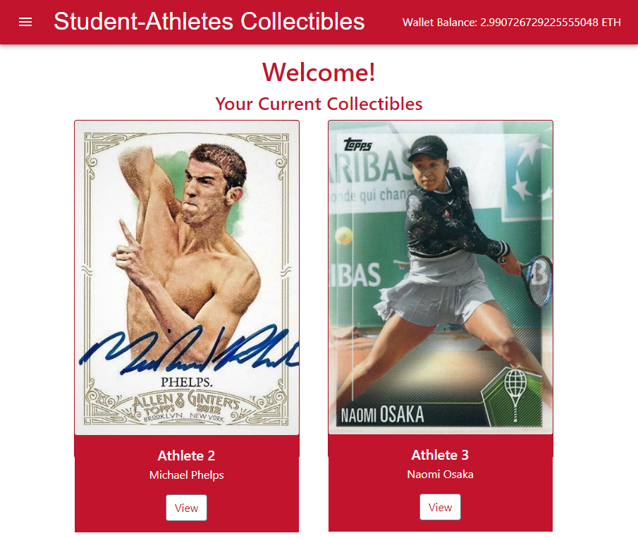
Artifact Demonstration
NFTs
Smart contracts on Ethereum and Avalanche
Front end
Node.js
Notes:
IPFS

Slide 25
Artifact Evaluation
Goal: “comparison of the artifact’s functionality with the solution objectives” (Peffers et al., 2007)
Interview with 12 student-athletes
After demonstrating the artifact
Sample questions:
“Do you think the solution is useful to reward all student-athletes? Why (not)?”
“Do you think the solution will allow for more fairness/opportunities when it comes to exploring NIL regulatory changes? Why (not)?”

Slide 26
Artifact Evaluation
Sample answers (inclusiveness):
“It [the solution] has the potential to benefit everybody, not just you know the star athletes. So, I like it.”
“They [fans] have an athlete on there [a random pack] that they didn’t know who it was, but then they might look into them and kind of know who the athlete is and literally put a face to the name, and help them [student-athletes] build their brand a little bit too.”

Slide 27
Artifact Evaluation
Sample answers (fairness):
“If, you know, one of these famous athletes cards went out - say the original pack was bought for a lower price than what the actual value of the card was worth because it was just in this random pack - but then, once it gets traded [in a secondary market] I’m sure there will be plenty of money to make up the difference.”

Slide 28
Summary
Study on the prospect of NFTs creating NIL opportunities
Design-science study
Conducted the first design cycle
Artifact
Royalties
Randoms packs in primary markets
Direct sales in secondary markets
Strong evidence that the artifact supports inclusiveness and fairness

Slide 29
Ongoing Work (Second Design Cycle)
Generalization of our results
Interviews with semi- and pro athletes in Europe
Design theory
Quantitative evaluation of different probability distributions for the random packs
Notes:
For a population of student-athletes, say 100, how many sales on average does it take for all NFTs to have one sale? Do this for our proposed approach as well as the pure uniform distribution
How close is the empirical distribution to the uniform distribution after a number of sales? Repeat the experiment 100 times. Each time, have 1000 sales. After each sale, calculate the KL divergence between the empirical an uniform distribution for the two weighting schemes (uniform and empirical). Report two plots: average over the 100 runs for proposed scheme vs uniform distribution

Slide 30
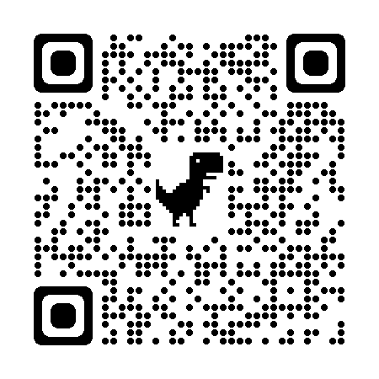

Thank you
Stay in touch
Email: arthur.carvalho@miamioh.edu
Twitter:
_Art_Carvalho
LinkedIn:
arthurgcarvalho

Slide 31

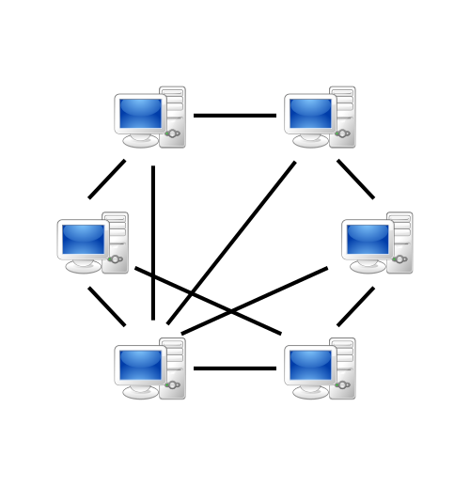
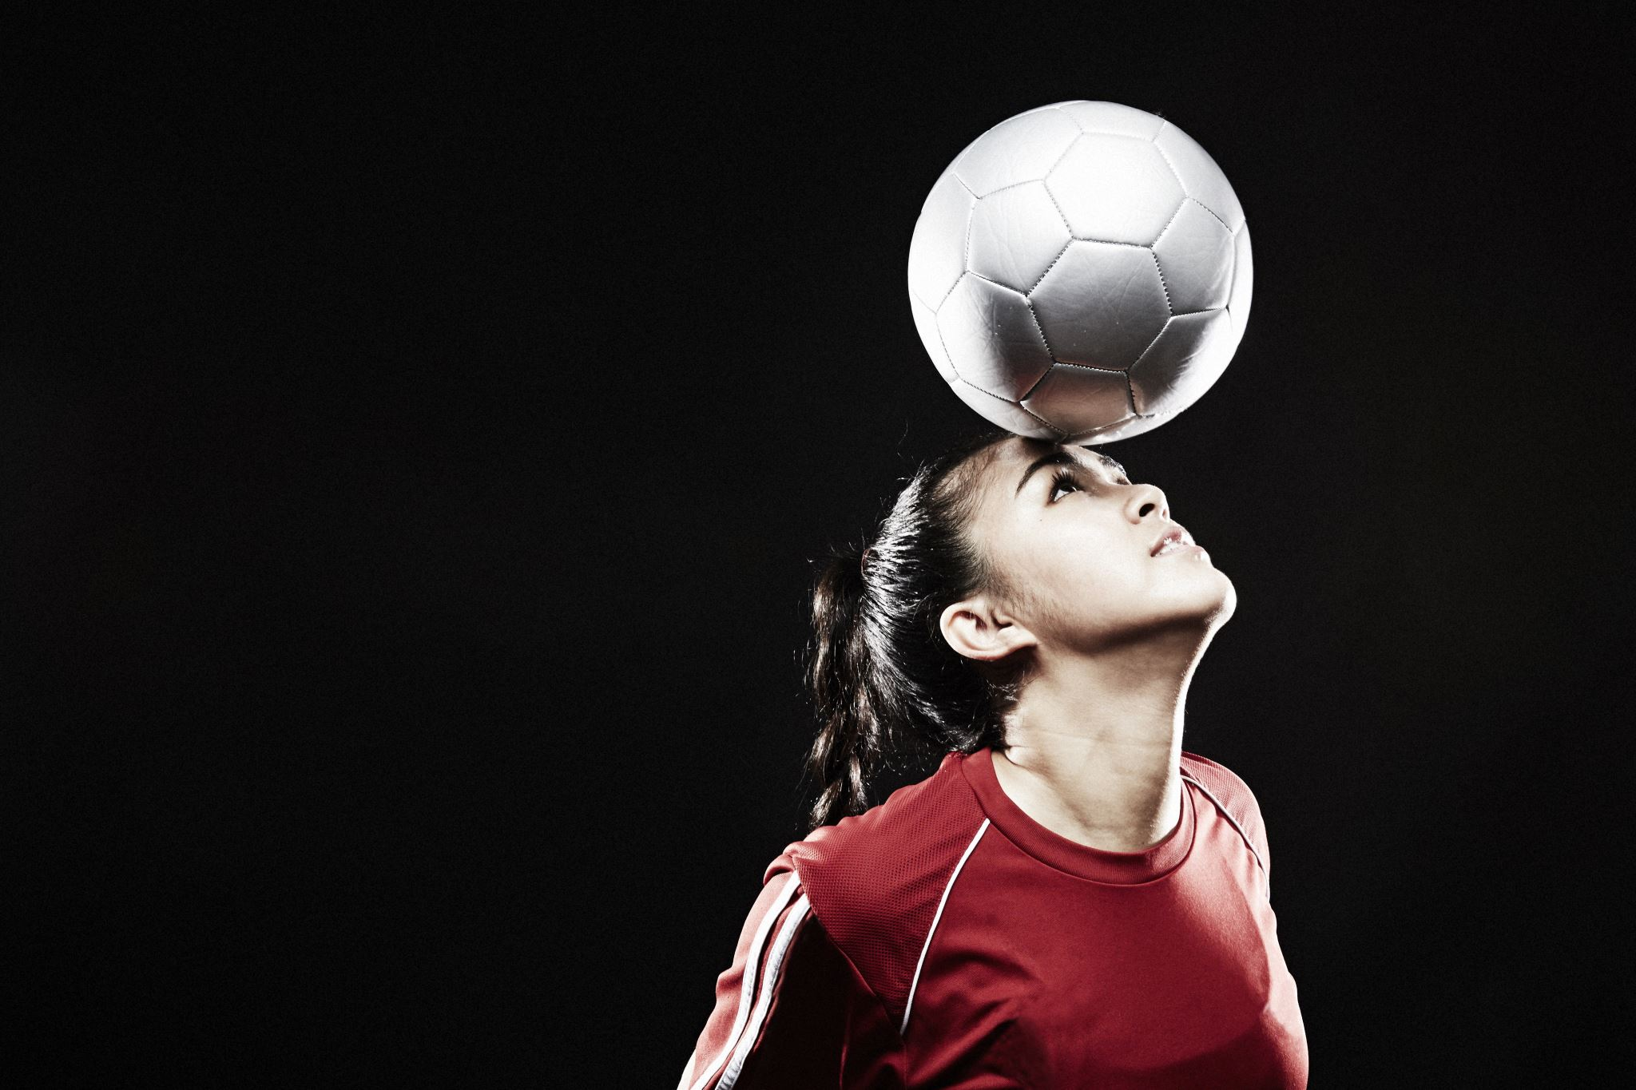

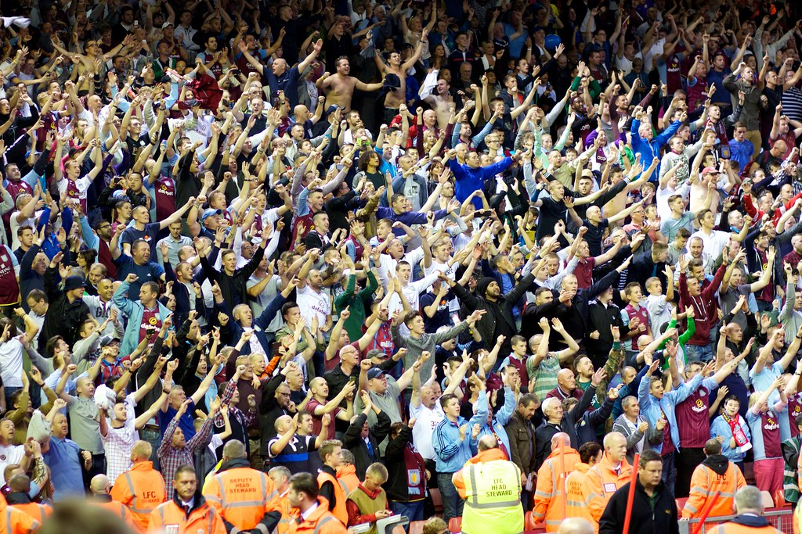
NFTs
Sports (cont.)
NFT platform for Student-Athletes
Platform
Student-Athlete
Blockchain
Collectibles
(NFTs)
Ownership data
Money
Transactions
Money
Fans
Incentives
(Perks)
Athletics Department
This Photo by Unknown Author is licensed under CC BY

